Slide 1
De novo design of molecules for a biological target
Anshul Yadav
Nishant
Sathiyamoorthy A

Slide 2
Introduction
Our goal is to construct a ligand from molecular fragments, leveraging a Monte Carlo with simulated annealing.

Slide 3
Methodology
The algorithm begins by constructing a fragment from a initial 3D point.
Next, it randomly selects a fragment from the available pool and add it into the ligand that has been computed thus far.
3d structure of ligand is calculated using RDKIT.
Then score of new ligand is calculated using autodock vina.
Score is used in Metropolis acceptance criteria to determine the acceptance of the new ligand.
Algorithm continues adding fragments until the ligand reaches the specified size.

Slide 4
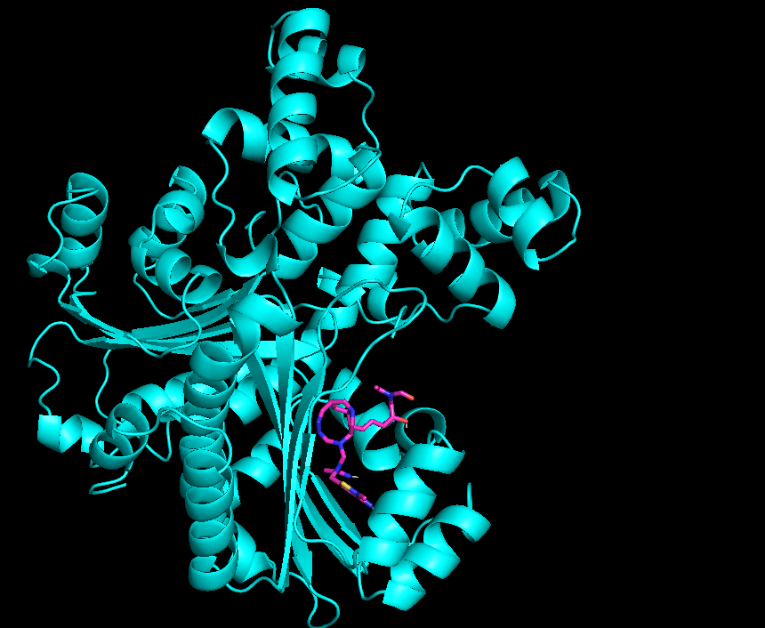
Results
Ligand = CCN(C=O)C(=C)C1(O)CC1C=CC1C2CN3CC(CC13)C=NN=CN2CN(CC1=CC(=N)N(C)S1)C(C)=N
Energy = -7.526

Slide 5
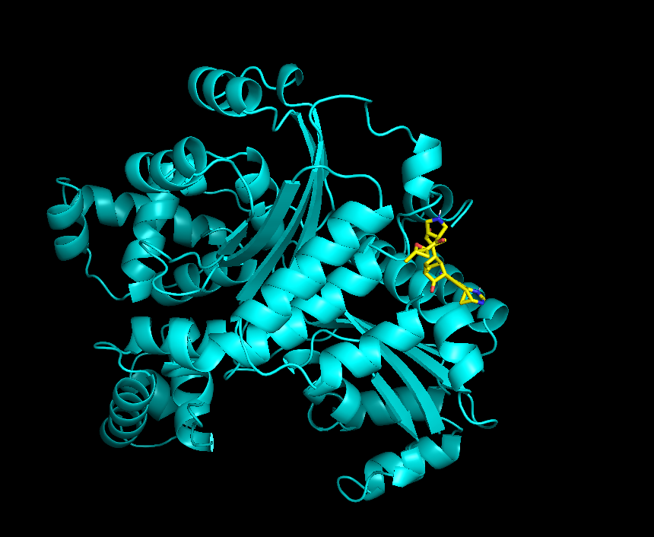
Ligand = CC1CC(O1)C(=O)C1CNCC1OCC(C)C1C2CC(C1C)C(=O)C2C#CC12CC1N=CNC2=CC#N
Energy = -8.007

Slide 6
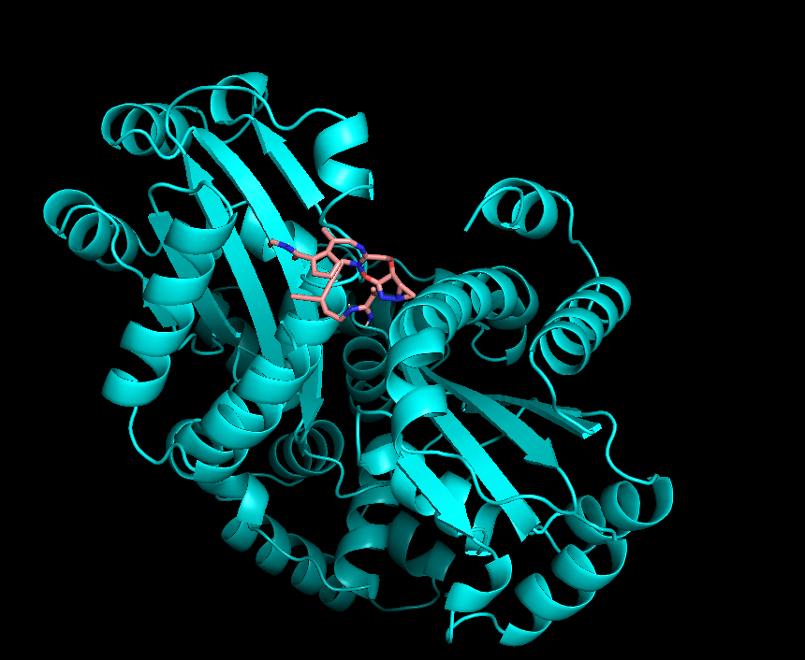
Ligand = C=CC(=N)NCC=C(C#C)C#CCN1OC2=NN3CC3C2OCC1=NCC(C)=C1C=CC=C1C(=O)NC=O
Energy = -7.11

Slide 7
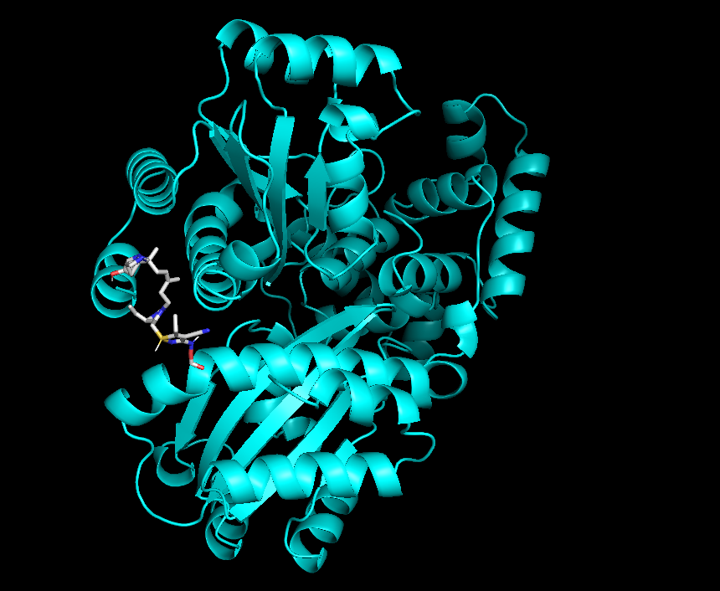
Ligand = CCC1=C(C#N)C(NOC=O)=NS1CC1C(C=C)N=CN1CCC(C)=CCC1(C)NCC2C3C4C(O)C4NC123
Energy = -7.238

